Slide 1
Collision-free positioning of optical fibers
From MOONs to Sloan

Slide 2
Program
From MOONS to Sloan : reminder
Presentation of the jobs done
Presentation of the jobs ongoing
Recap
To do list

Slide 3
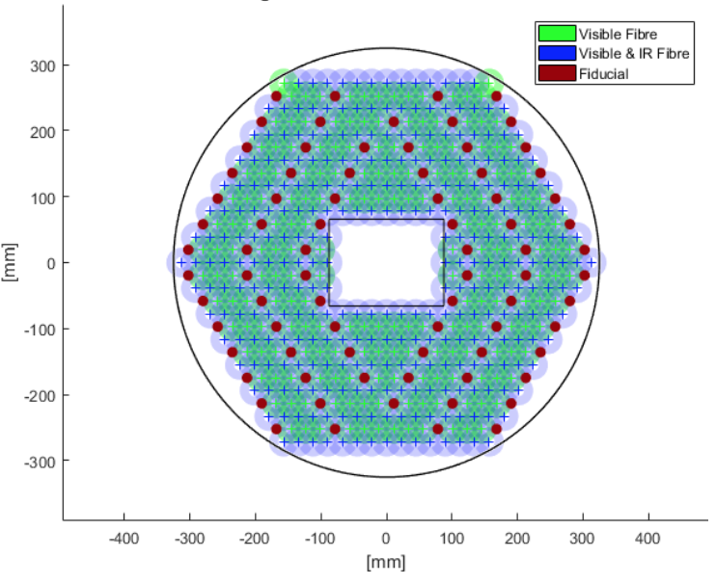
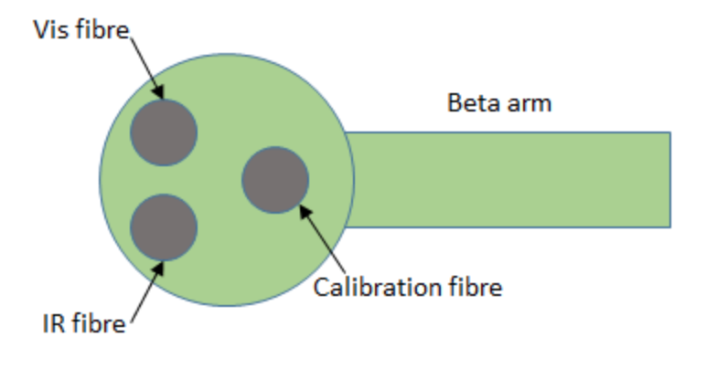
From MOONS to Sloan reminder
Specific motor arrangement
500 motors
Void rectangle at the center
From 1 to 3 fibers available
Only some motors own an IR fiber
The target is not set on the middle of the ferule anymore

Slide 4
Job Done
Parameter program
Circles program
Set_target update for fibers
Target generator to test the program

Slide 5
Parameter file
Purpose : group all parameters (dimensions, decentralized navigation function, simulation constants) in one text file.

Slide 6
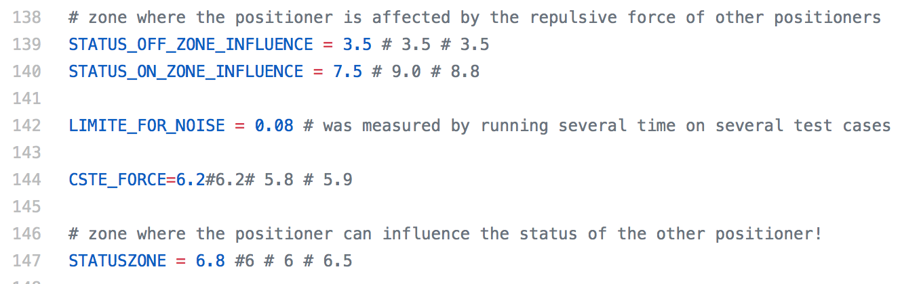
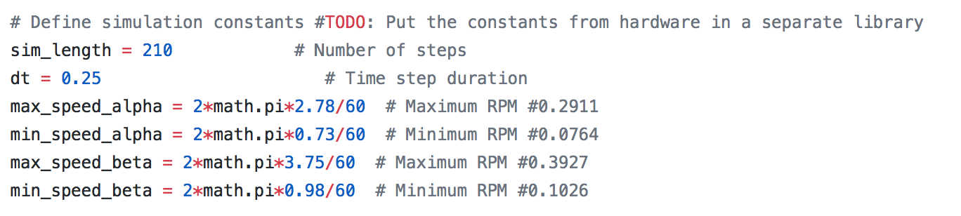
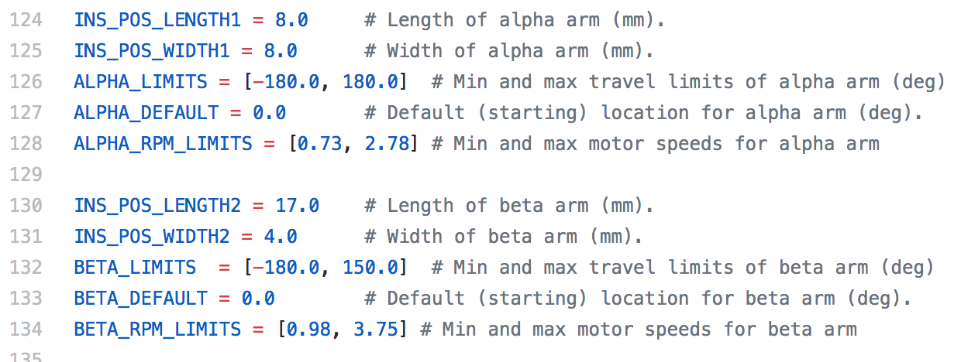
Parameter file
Before

Slide 7
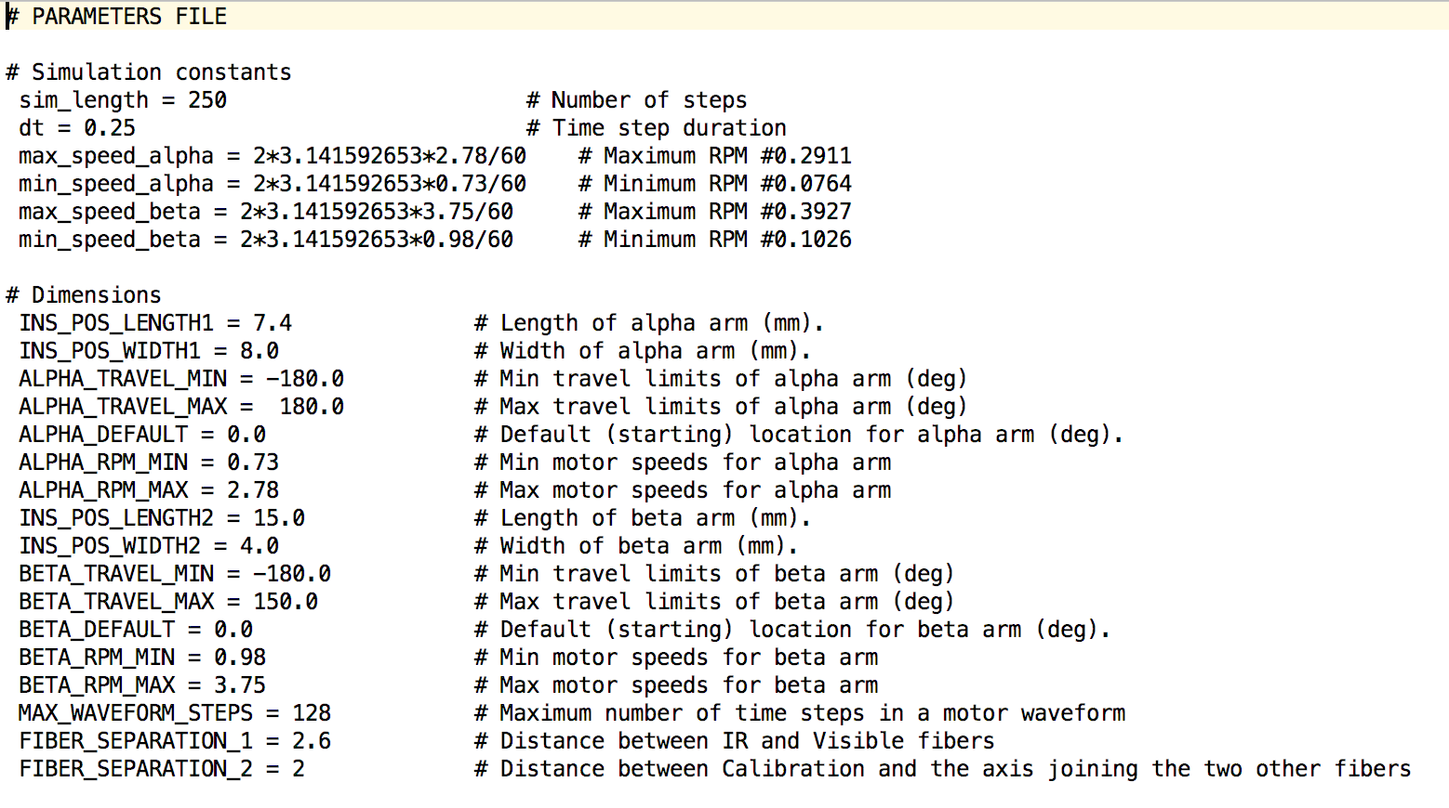
Parameter file
Before
After

Slide 8
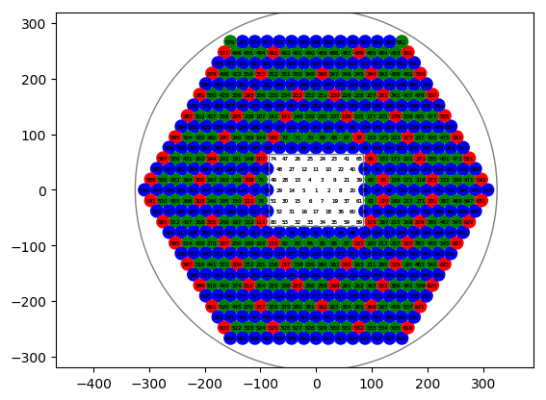
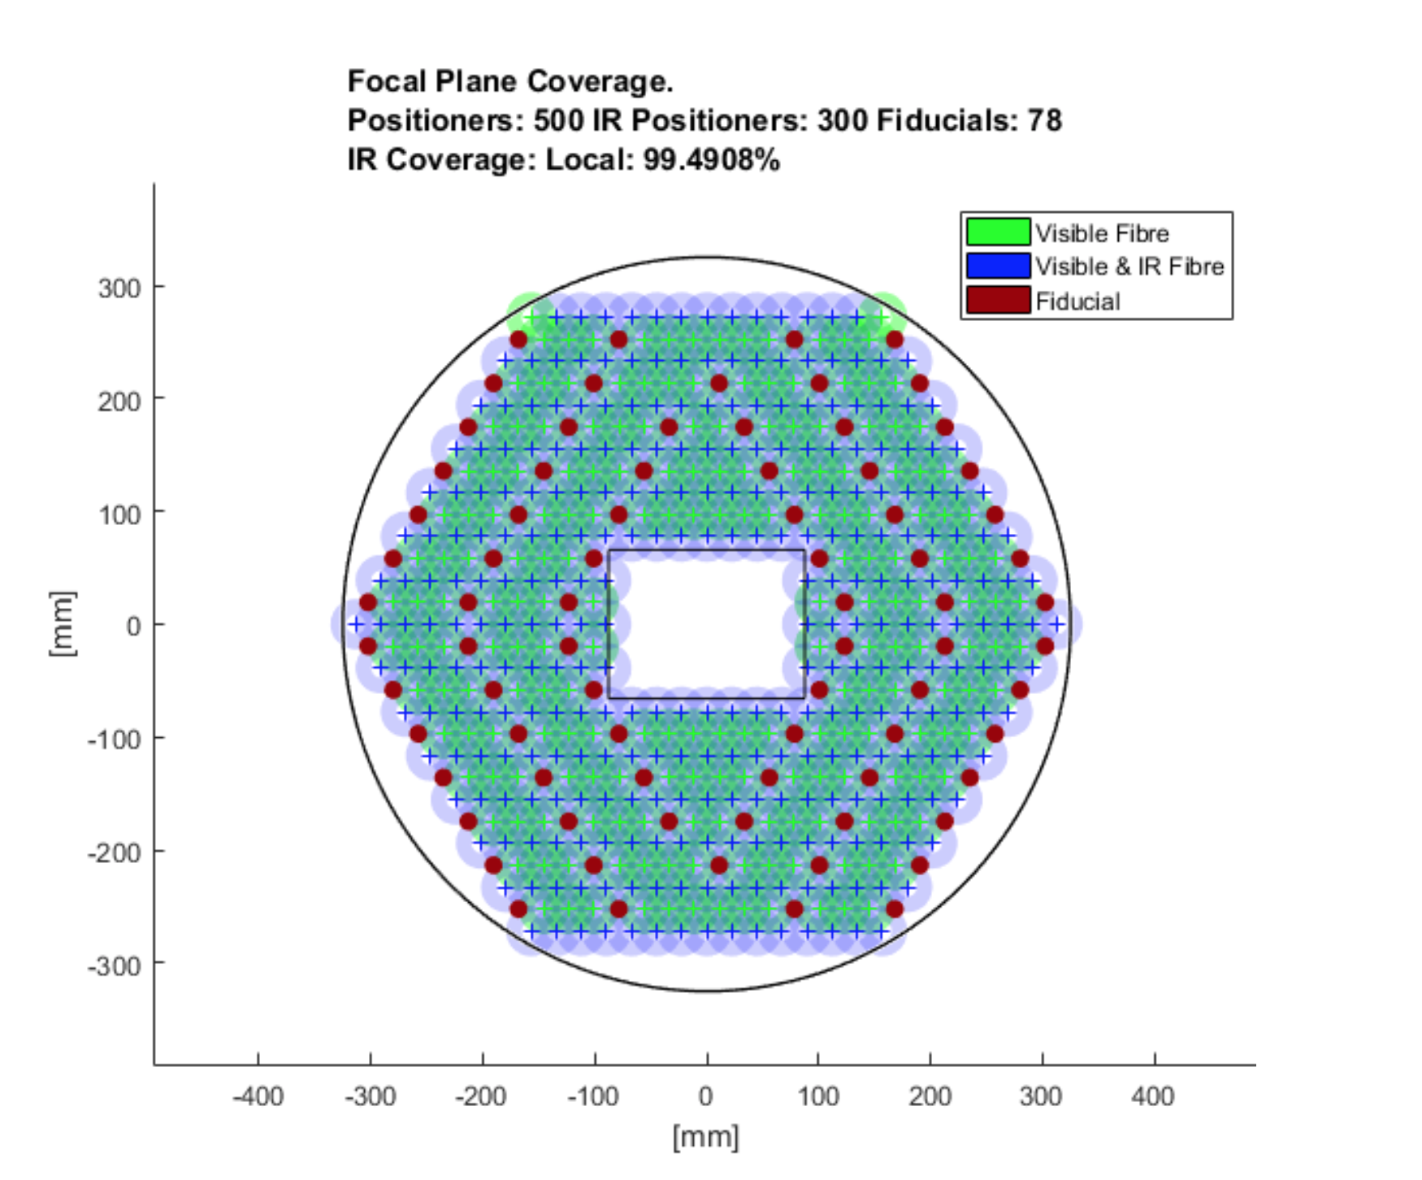
Circles program
Purpose : creating a program spawning the hexagonal shape of the positioner ensemble, containing positions and fiber properties in arrays to be used everywhere else in the software.

Slide 9
Circles program
Purpose : creating a program spawning the hexagonal shape of the motor ensemble, containing positions and fiber properties in arrays to be used everywhere else in the software.
Operation :
Creates a circle at position (0,0)
Surrounds this circles with 6 circles
Repeat the process until the wished number

Slide 10
Circles program
Advantages :
No need of the cfg file for the motor coordinates (very long for the entire telescope)
Every information concerning positions and fibers automatically generated
Easy visualization
Disadvantages :
Hardcoding if necessity to change anything
Rectangle at the center is programmed to be filled with motors unable to set any target

Slide 11
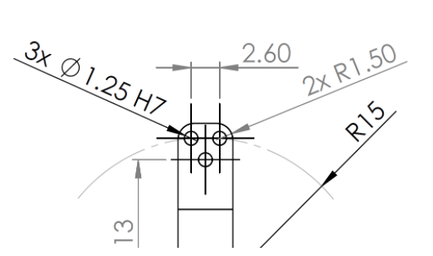
Set_target update for fibers
Purpose : moving the motor to a close position of the center of the ferule, under the wished fiber

Slide 12
Set_target update for fibers
Possibilities :
Displacing the position of the target depending on the choice of the fiber
Moving each motors to the target (under the center), and then ask a small displacement to move the fiber under the target
Changing the coordinates of the wished position for each motor, depending on the wished fiber

Slide 13
Set_target update for fibers
Possibilities :
Displacing the position of the target depending on the choice of the fiber -> adds confusion and problems for visualization.
Moving each motors to the target (under the center), and then ask a small displacement to move the fiber under the target -> clash and DNF problems
Changing the coordinates of the wished position for each motor, depending on the wished fiber (modifying the set_target in fps_shared script).

Slide 14
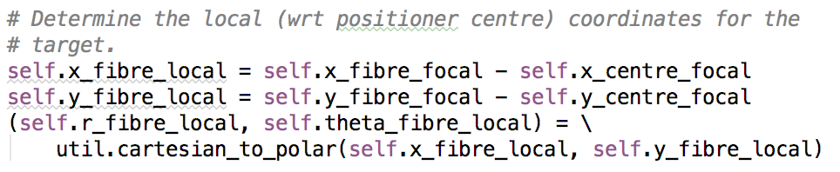
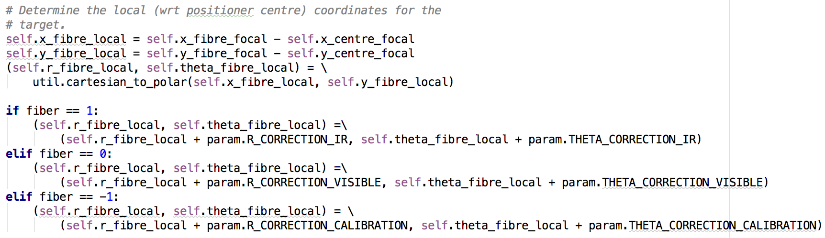
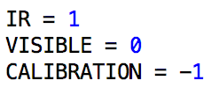
Set_target update for fibers

Slide 15
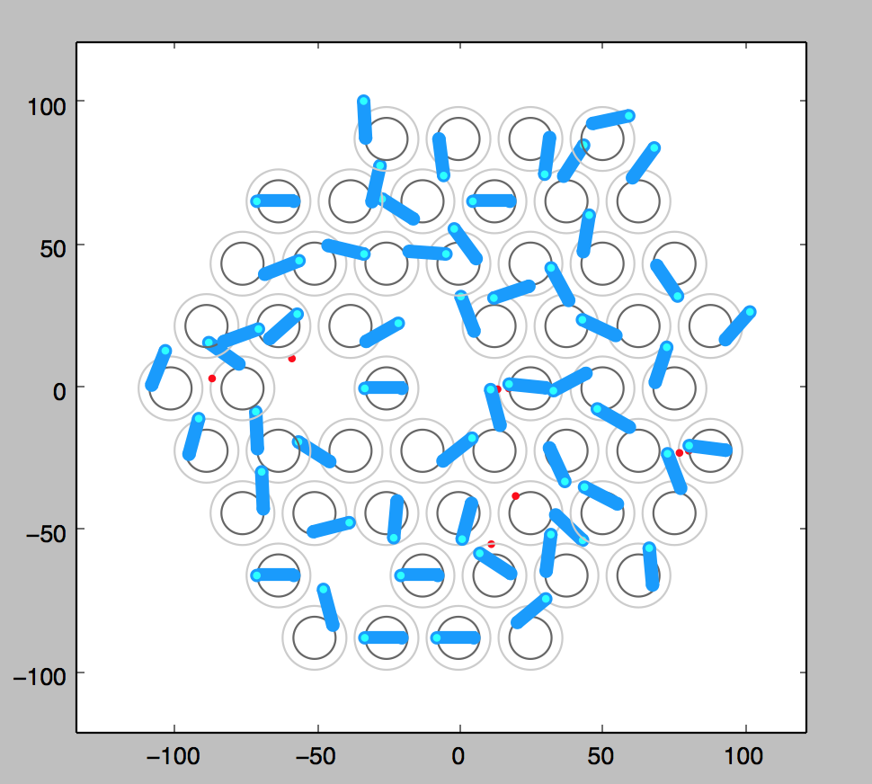
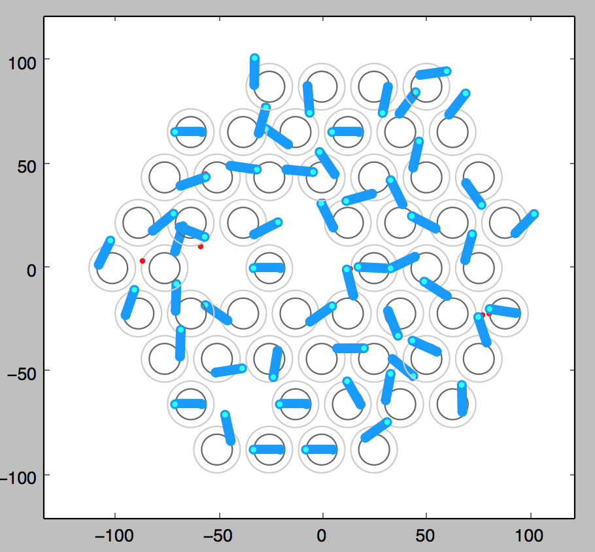
Set_target update for fibers
No correction
With correction

Slide 16
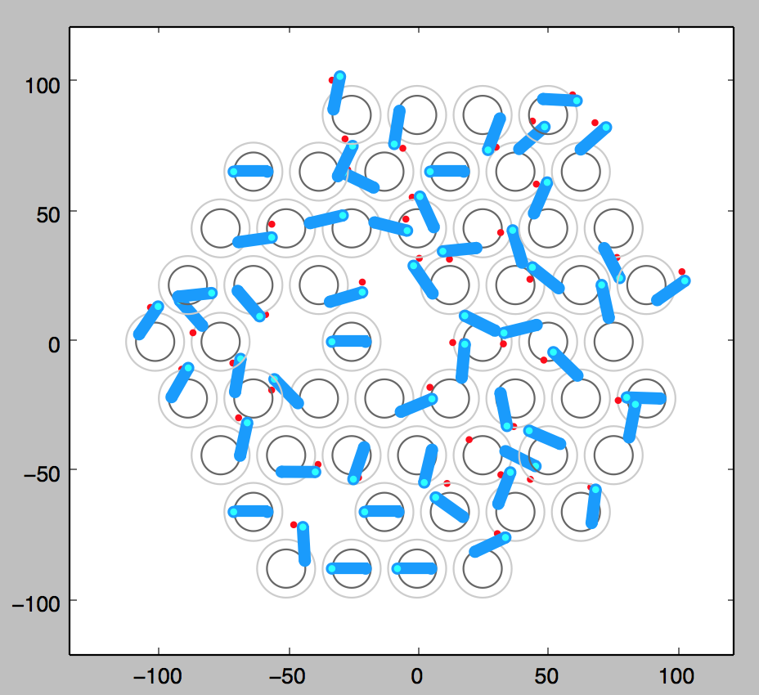
Set_target update for fibers
No correction
With correction
With correction x4

Slide 17
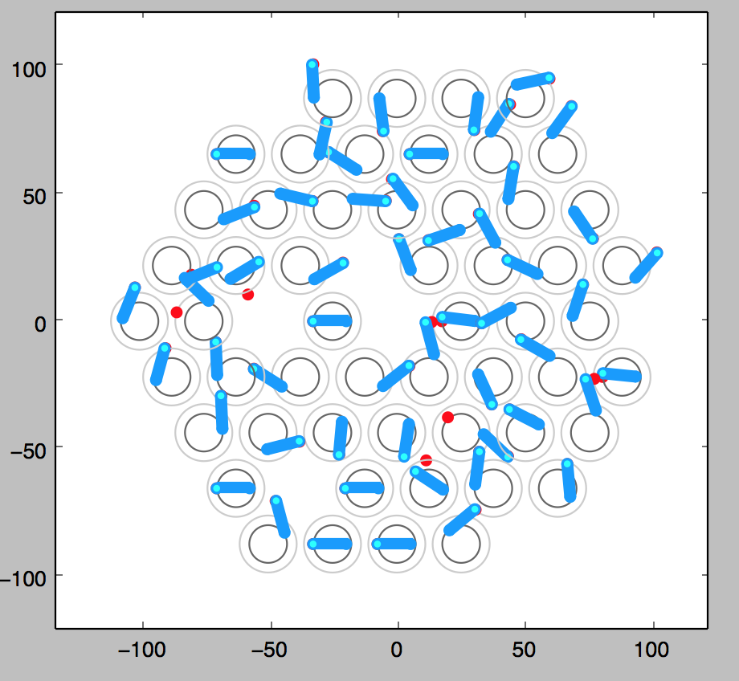
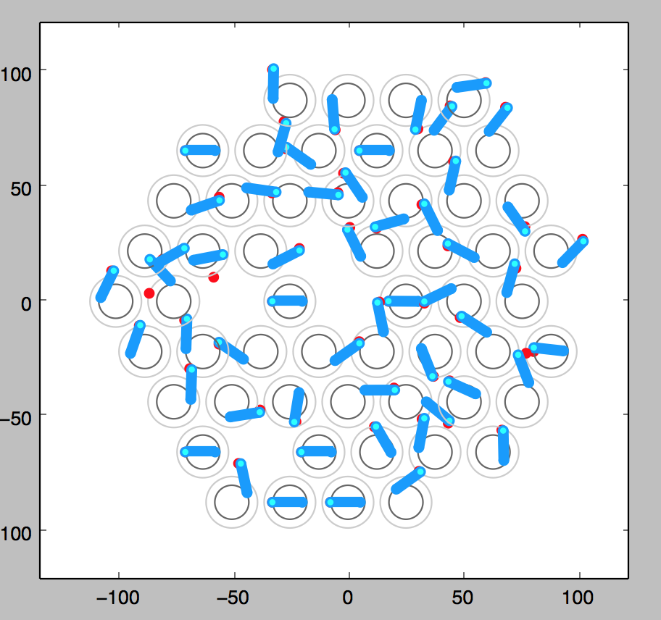
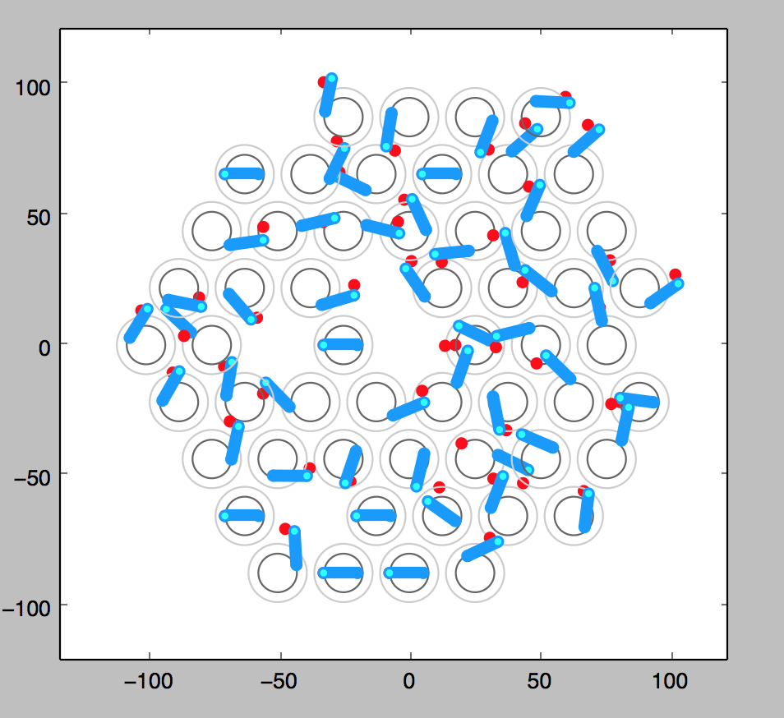
Set_target update for fibers
No correction
With correction
With correction x4

Slide 18
Target generator
Purpose : having a bank of target files to test the software when ready
5 types :
Random
Random with normal distribution on the center
Focused on a random place
Focused on a random place with normal distribution
Homogeneous (looks like former target files)
Plots available

Slide 19
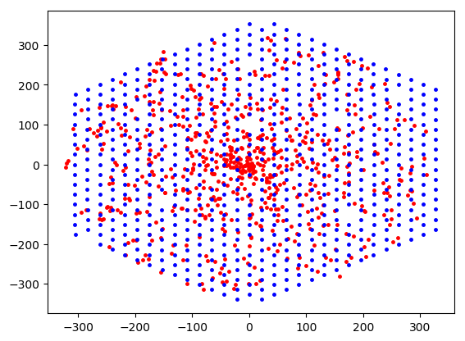
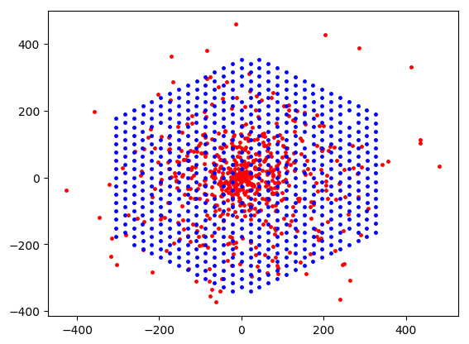
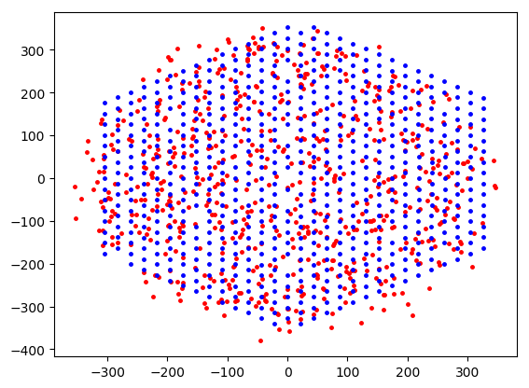
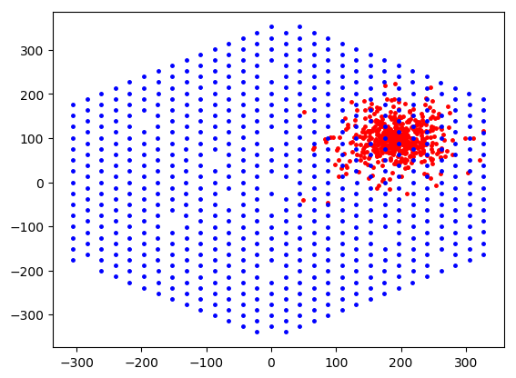
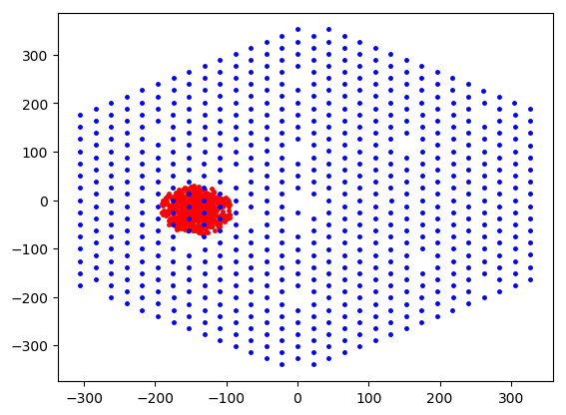
Target generator
Random
Random normal
Homogeneous
Focus normal
Focus

Slide 20
Ongoing job : fiber attribution
Purpose : set a motor to a target only if this motor contains the necessary fiber

Slide 21
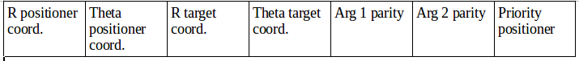
Ongoing job : fiber attribution
Purpose : set a positioner to a target only if this motor contains the necessary fiber
Operation :
New column in the target file, indicating which fiber to choose
Before
After
R positioner coord. | Theta positioner coord. | R target coord. | Theta target coord. | Arg 1 parity | Arg 2 parity | Priority positioner | Fiber

Slide 22
Ongoing job : fiber attribution
Purpose : set a positioner to a target only if this motor contains the necessary fiber
Operation :
New column in the target file, indicating which fiber to choose
Program generating random fiber attribution to any former target file
If a positioner is “empty” (empty rectangle for Sloan) or a fiducial, target is not set
If the target needs IR fiber, but the proposed positioner only has visible and calibration, target is not set
If the target needs IR fiber, and the proposed positioner owns an IR fiber, nothing changes
If the target needs visible or calibration fiber, nothing changes

Slide 23
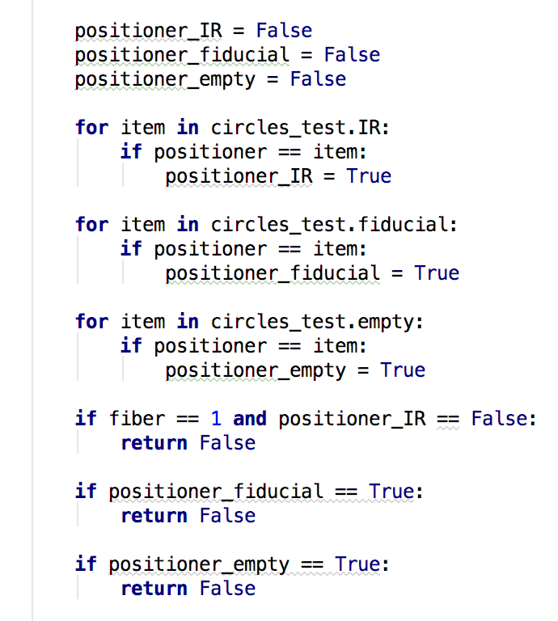
Ongoing job : fiber attribution
Operation :
New column in the target file, indicating which fiber to choose
Program generating random fiber attribution to any former target file
If a positioner is “empty” (empty rectangle for Sloan) or a fiducial, target not set
If the target needs IR fiber, but the proposed motor only has visible and calibration, target not set
If the target needs IR fiber, and the proposed motor owns an IR fiber, nothing changes
If the target needs visible or calibration fiber, nothing changes

Slide 24
Recap
Parameter script and file managing parameters throughout the entire program.
Sloan positioner ensemble structure ready
Set_target updated for fibers
Target generator allow the test of the program when ready
Fiber attribution working: a visible-calibration positioner can not be set on a IR target. Fake (“empty”) and fiducial can not be set either.
Visualization problems
(don’t make updates 1 week before a presentation…)

Slide 25
To do
Fix visualization problems
Add fiducials in the DNF (to prevent positioner-fiducial clashes)
Commenting the code achieved (not yet began)
Making the code more elegant ?
Former to do list :
Improve algorithm to increase convergence rate
Improve prioritization

Slide 26
Thanks!
Any question/request?

